Slide 1
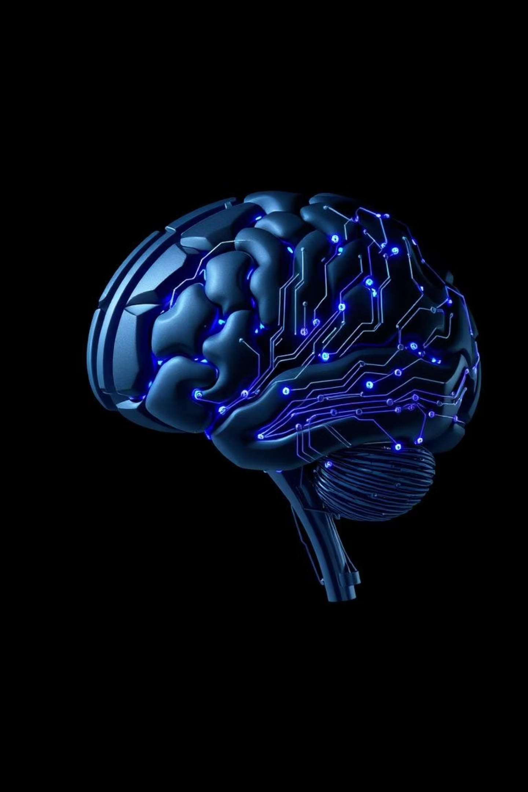
Generative AI – The Future of Creative Intelligence
Seminar Presentation by Naveen Hitnalli
2BA24MC019
Department of MCA
BEC BGK

Slide 2
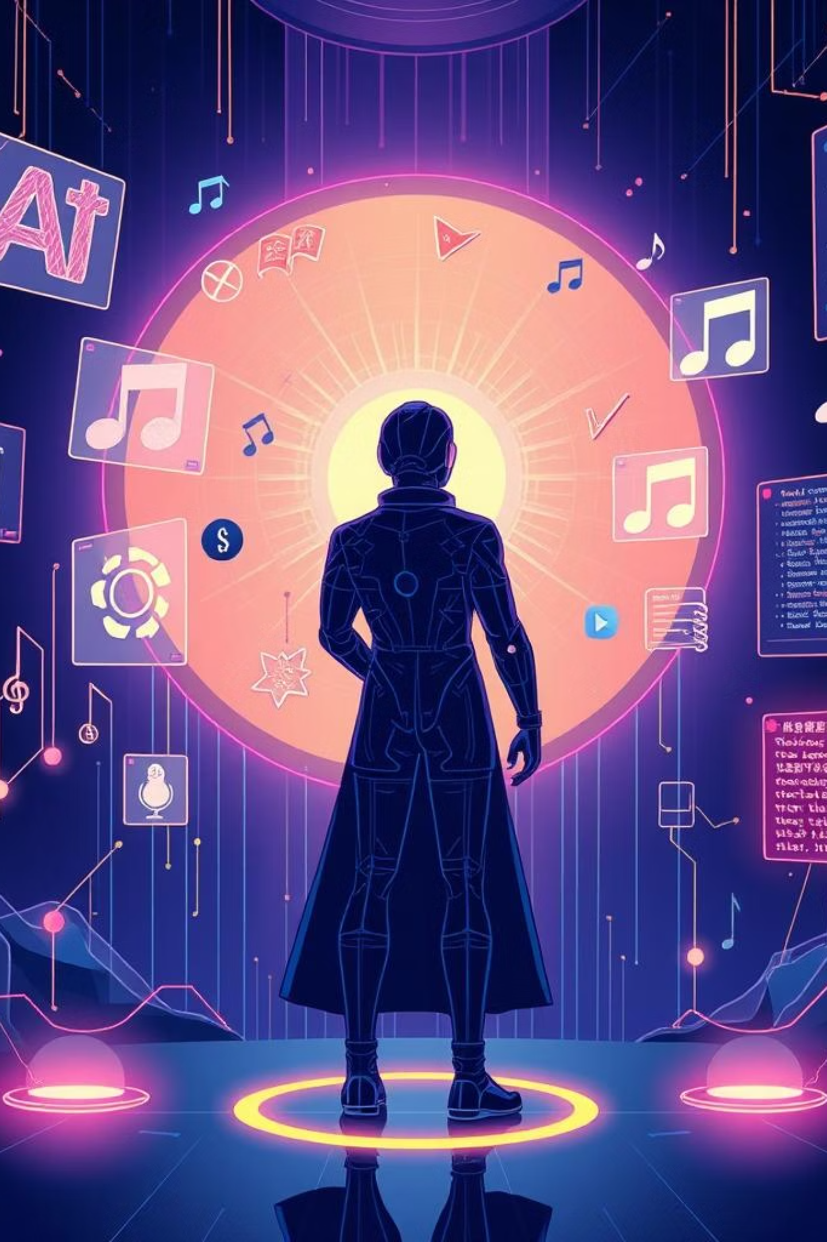
Generative AI: Shaping the Future of Creativity
Explore how Generative AI is revolutionizing creative fields, from art and music to text and video. Discover its potential, applications, and the challenges it presents.

Slide 3
Understanding Artificial Intelligence: A Quick Overview
1
Machine Learning
2
Deep Learning
3
AI broadly
Systems learn from data to identify patterns and make predictions without explicit programming.
A subset of ML using neural networks with multiple layers to learn complex representations of data.
Encompasses ML, DL, and other techniques enabling machines to simulate human intelligence.
AI is an umbrella term for technologies that enable machines to perform human-like cognitive functions.

Slide 4

What is Generative AI?
Generative AI is a branch of artificial intelligence that focuses on creating new content rather than just analyzing or processing existing data
Generative AI refers to AI models that can generate new data, such as text, images, music, code, or even videos — that closely mimic human-created content.
Generative Ai Models are trained on massive datasets using ML and particularly deep learning
Iy uses neural networks, especially transformer models like GPT
(Generative Pre-trained Transformer).
These models learn the structure and style of data and then generate similar but new content

Slide 5
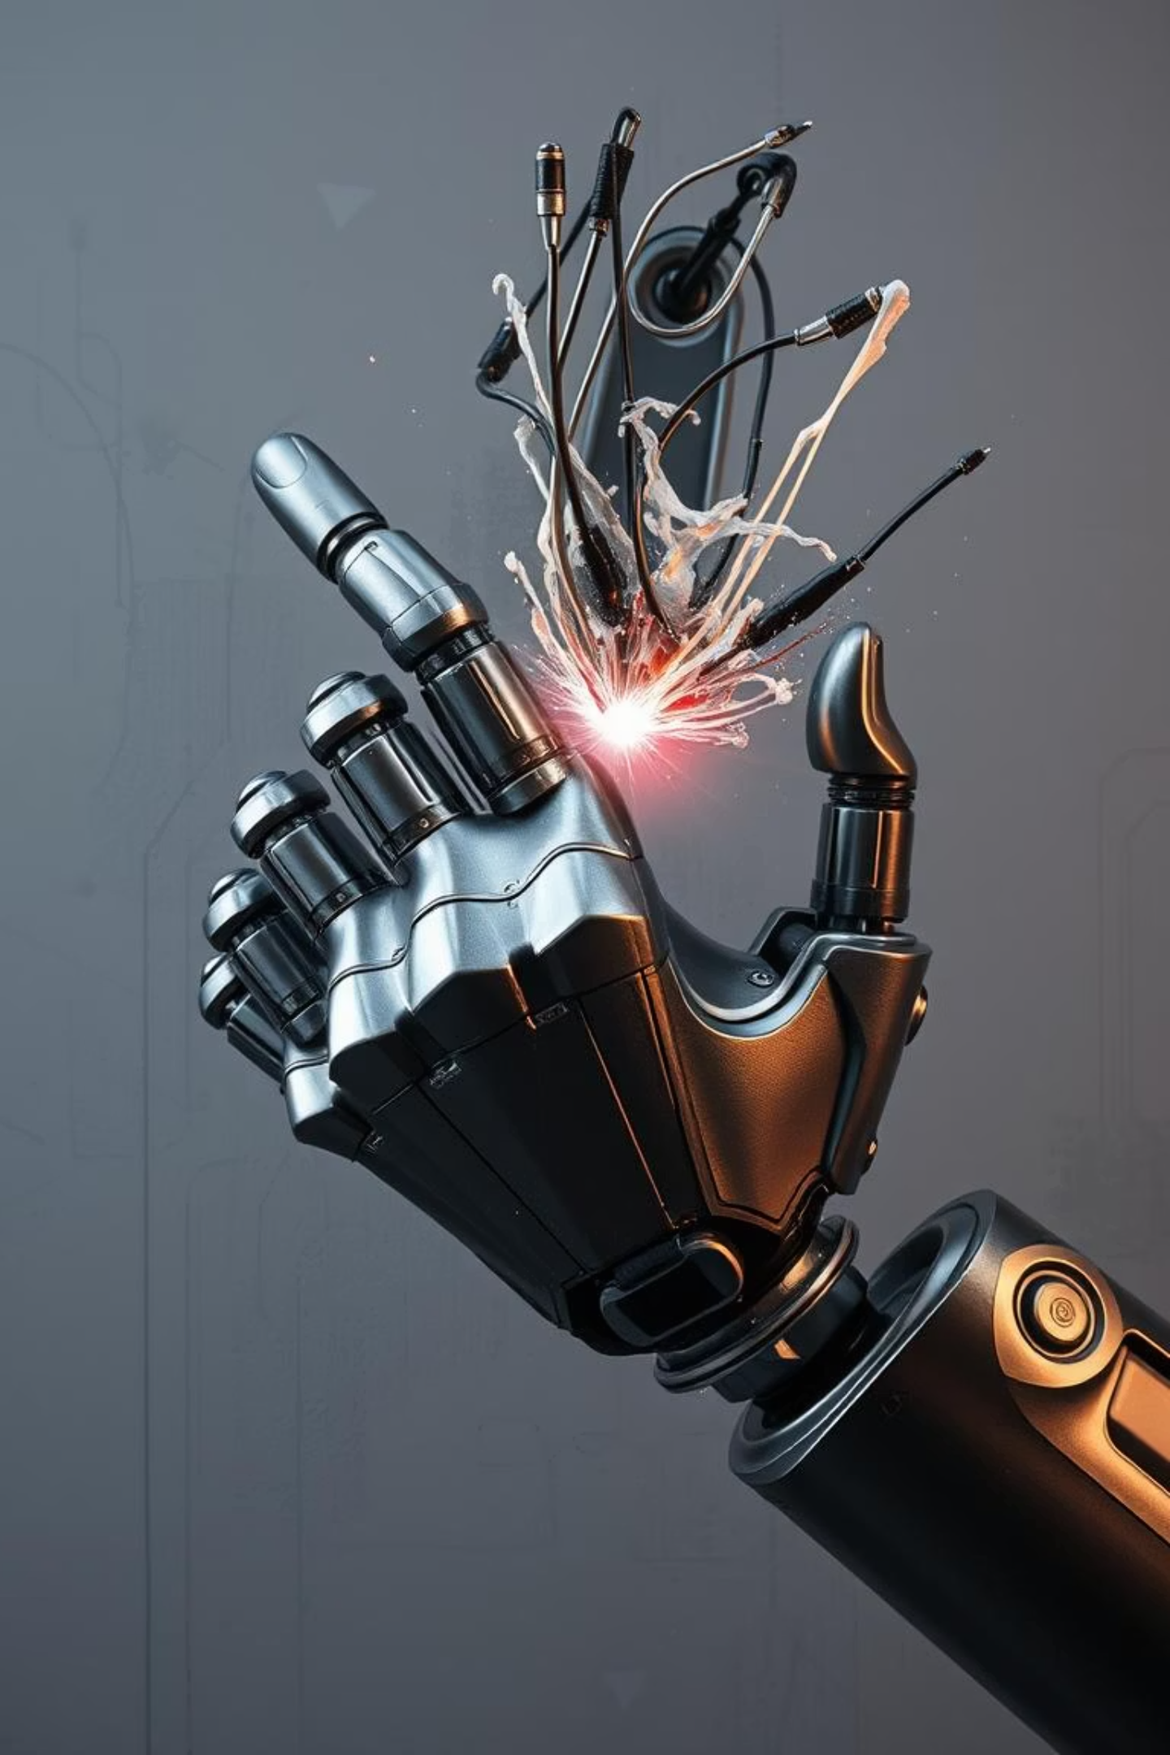



Why Generative AI Matters
Creative Machines
Machines gain ability to innovate and imagine.
Industry Impact
Revolutionizing design, media, research, and more.
Beyond Automation
From repetitive tasks to novel creations.

Slide 6
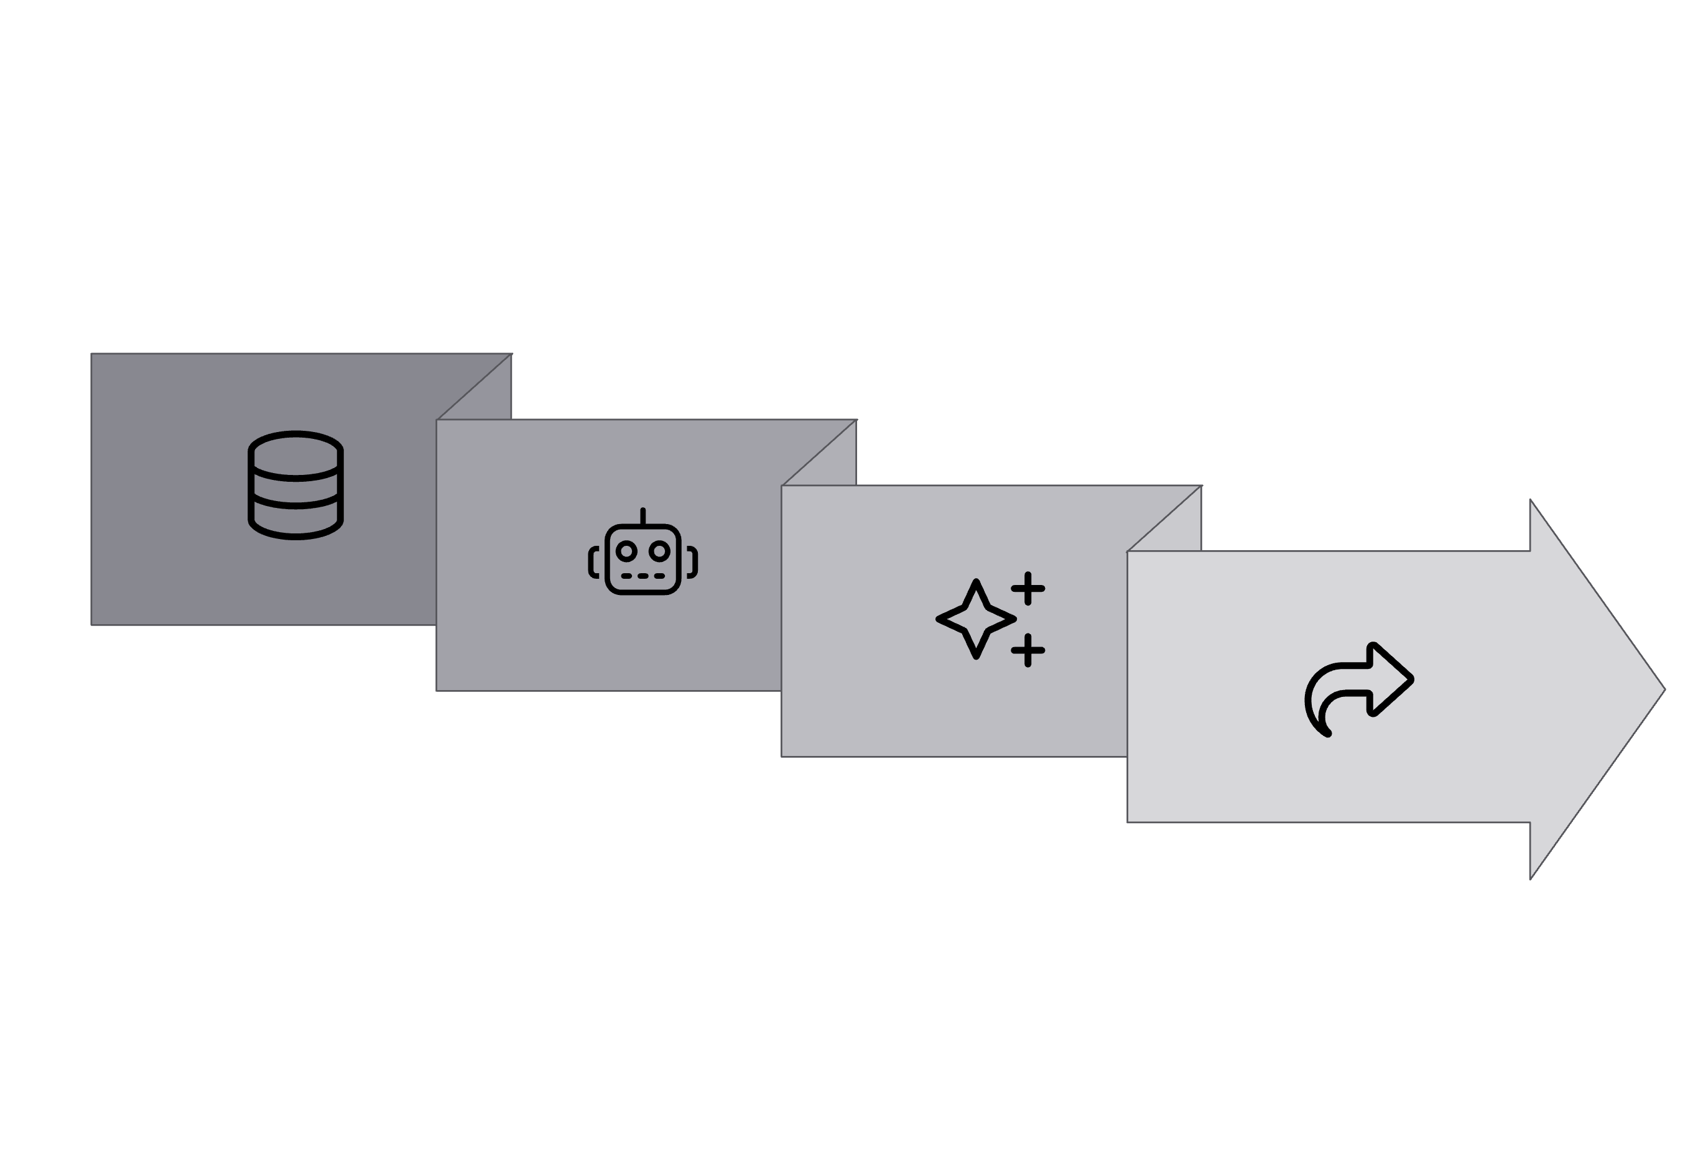


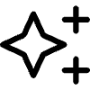

How Does Generative AI Work?
Model Training
Output
Data Input
Generation
Generative AI models learn the underlying distribution of training data and then sample from this learned distribution to create new data points.

Slide 7



Key Generative AI Models
GANs
VAEs
Transformers
Generative Adversarial Networks: Two neural networks (generator and discriminator) compete to produce realistic outputs.
Variational Autoencoders: Learn a compressed representation (latent space) of data to generate new examples.
Architectures (e.g., GPT) excel in sequential data like text, using attention mechanisms to model long-range dependencies.

Slide 8
Evolution of Generative AI
1950s-1980s
1
Early AI and symbolic methods, rule-based systems for content.
2
1990s-2000s
Statistical methods and Markov models for text and speech generation.
2014
3
GANs Introduced: Paving the way for realistic image and data synthesis.
4
2017
Transformers: Revolutionizing natural language processing and beyond.
2020s
5
Explosion of large generative models (GPT-3, DALL-E, Stable Diffusion) and widespread adoption.

Slide 9
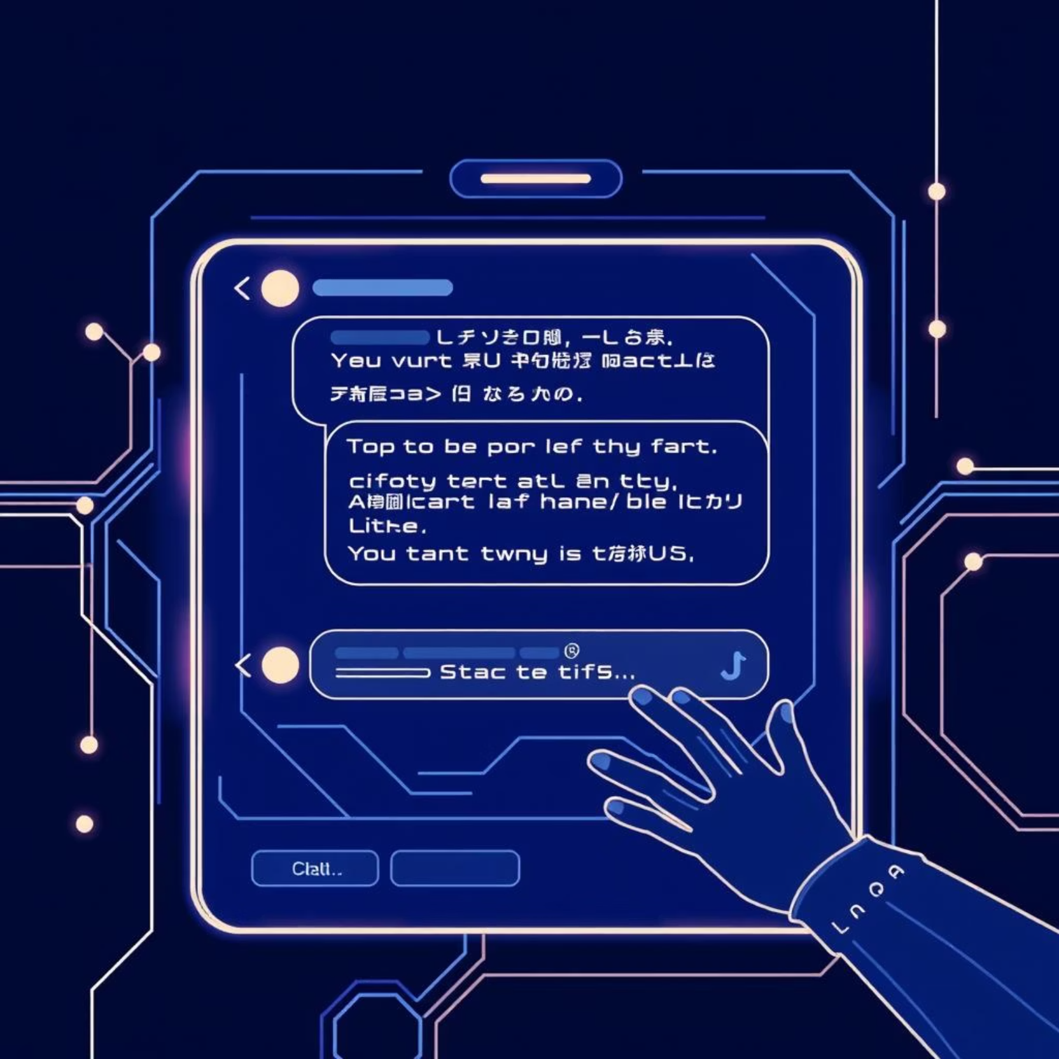
Text Generation: ChatGPT and Beyond
Language Models: Trained on vast text datasets to predict next words.
Applications: Writing articles, summarization, creative storytelling, code generation, customer service.
Examples: ChatGPT, Bard, LLaMA – driving new interaction paradigms.
Generative AI is transforming communication by enabling machines to understand and produce human-like language.

Slide 10
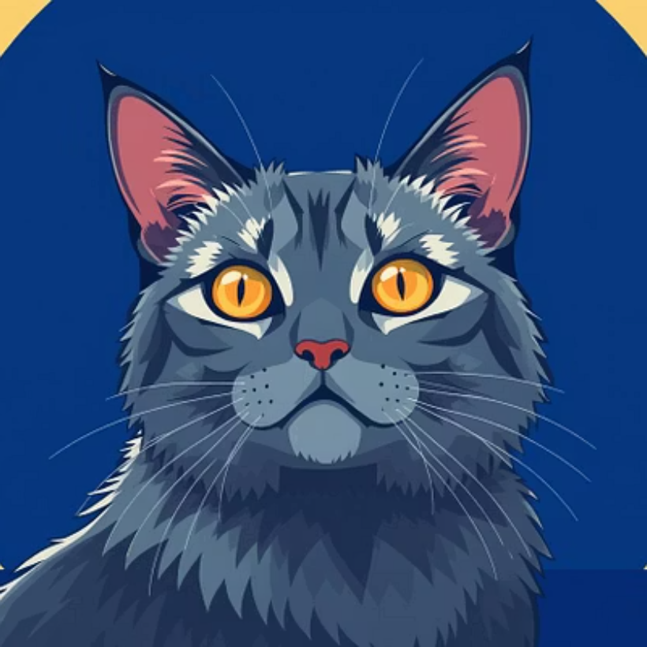
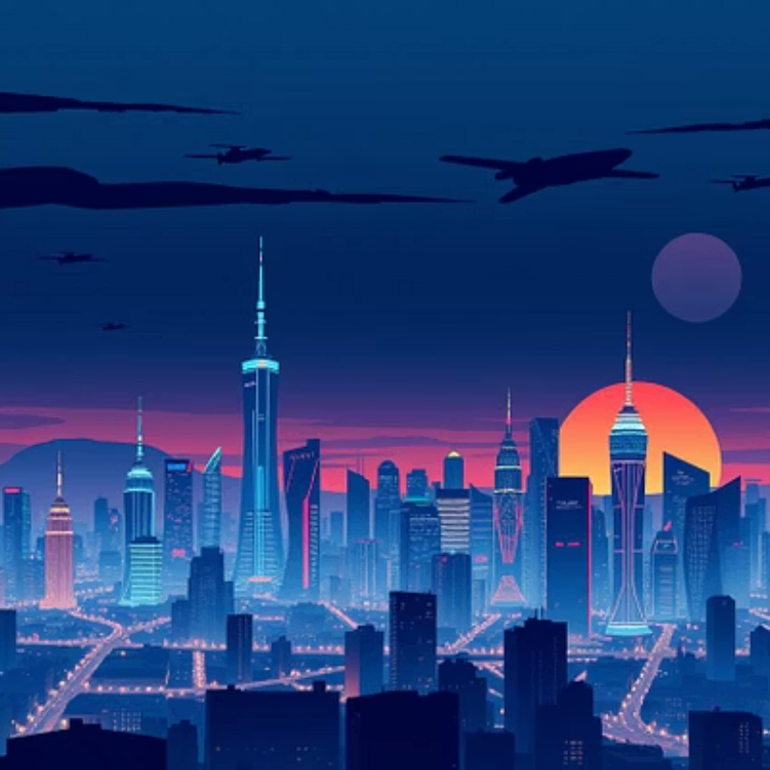
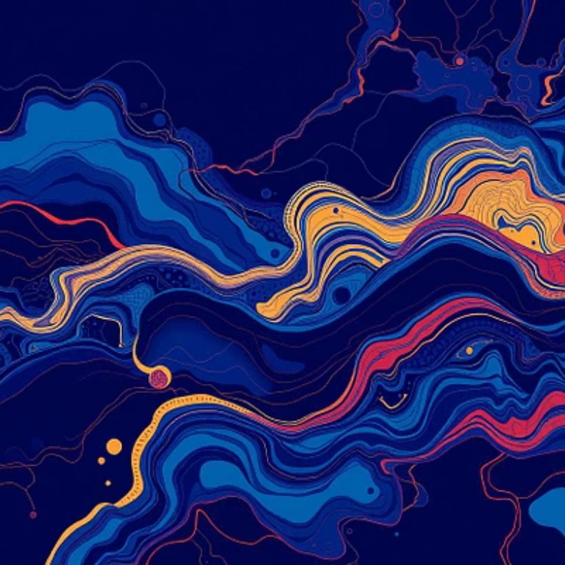

Image and Art Generation with AI
AI models can create stunning, original visual content from simple text prompts or existing images.

Slide 11

Music and Video Creation Using Generative AI
Music Composition
Video Synthesis
Generate unique melodies, harmonies, and full tracks in various styles. Assists artists in overcoming creative blocks and exploring new genres.
Create realistic or stylized video clips, deepfakes, and special effects from text, audio, or images. Revolutionizing film production.
Generative AI empowers creators to automate tedious tasks and produce content at an unprecedented scale.

Slide 12
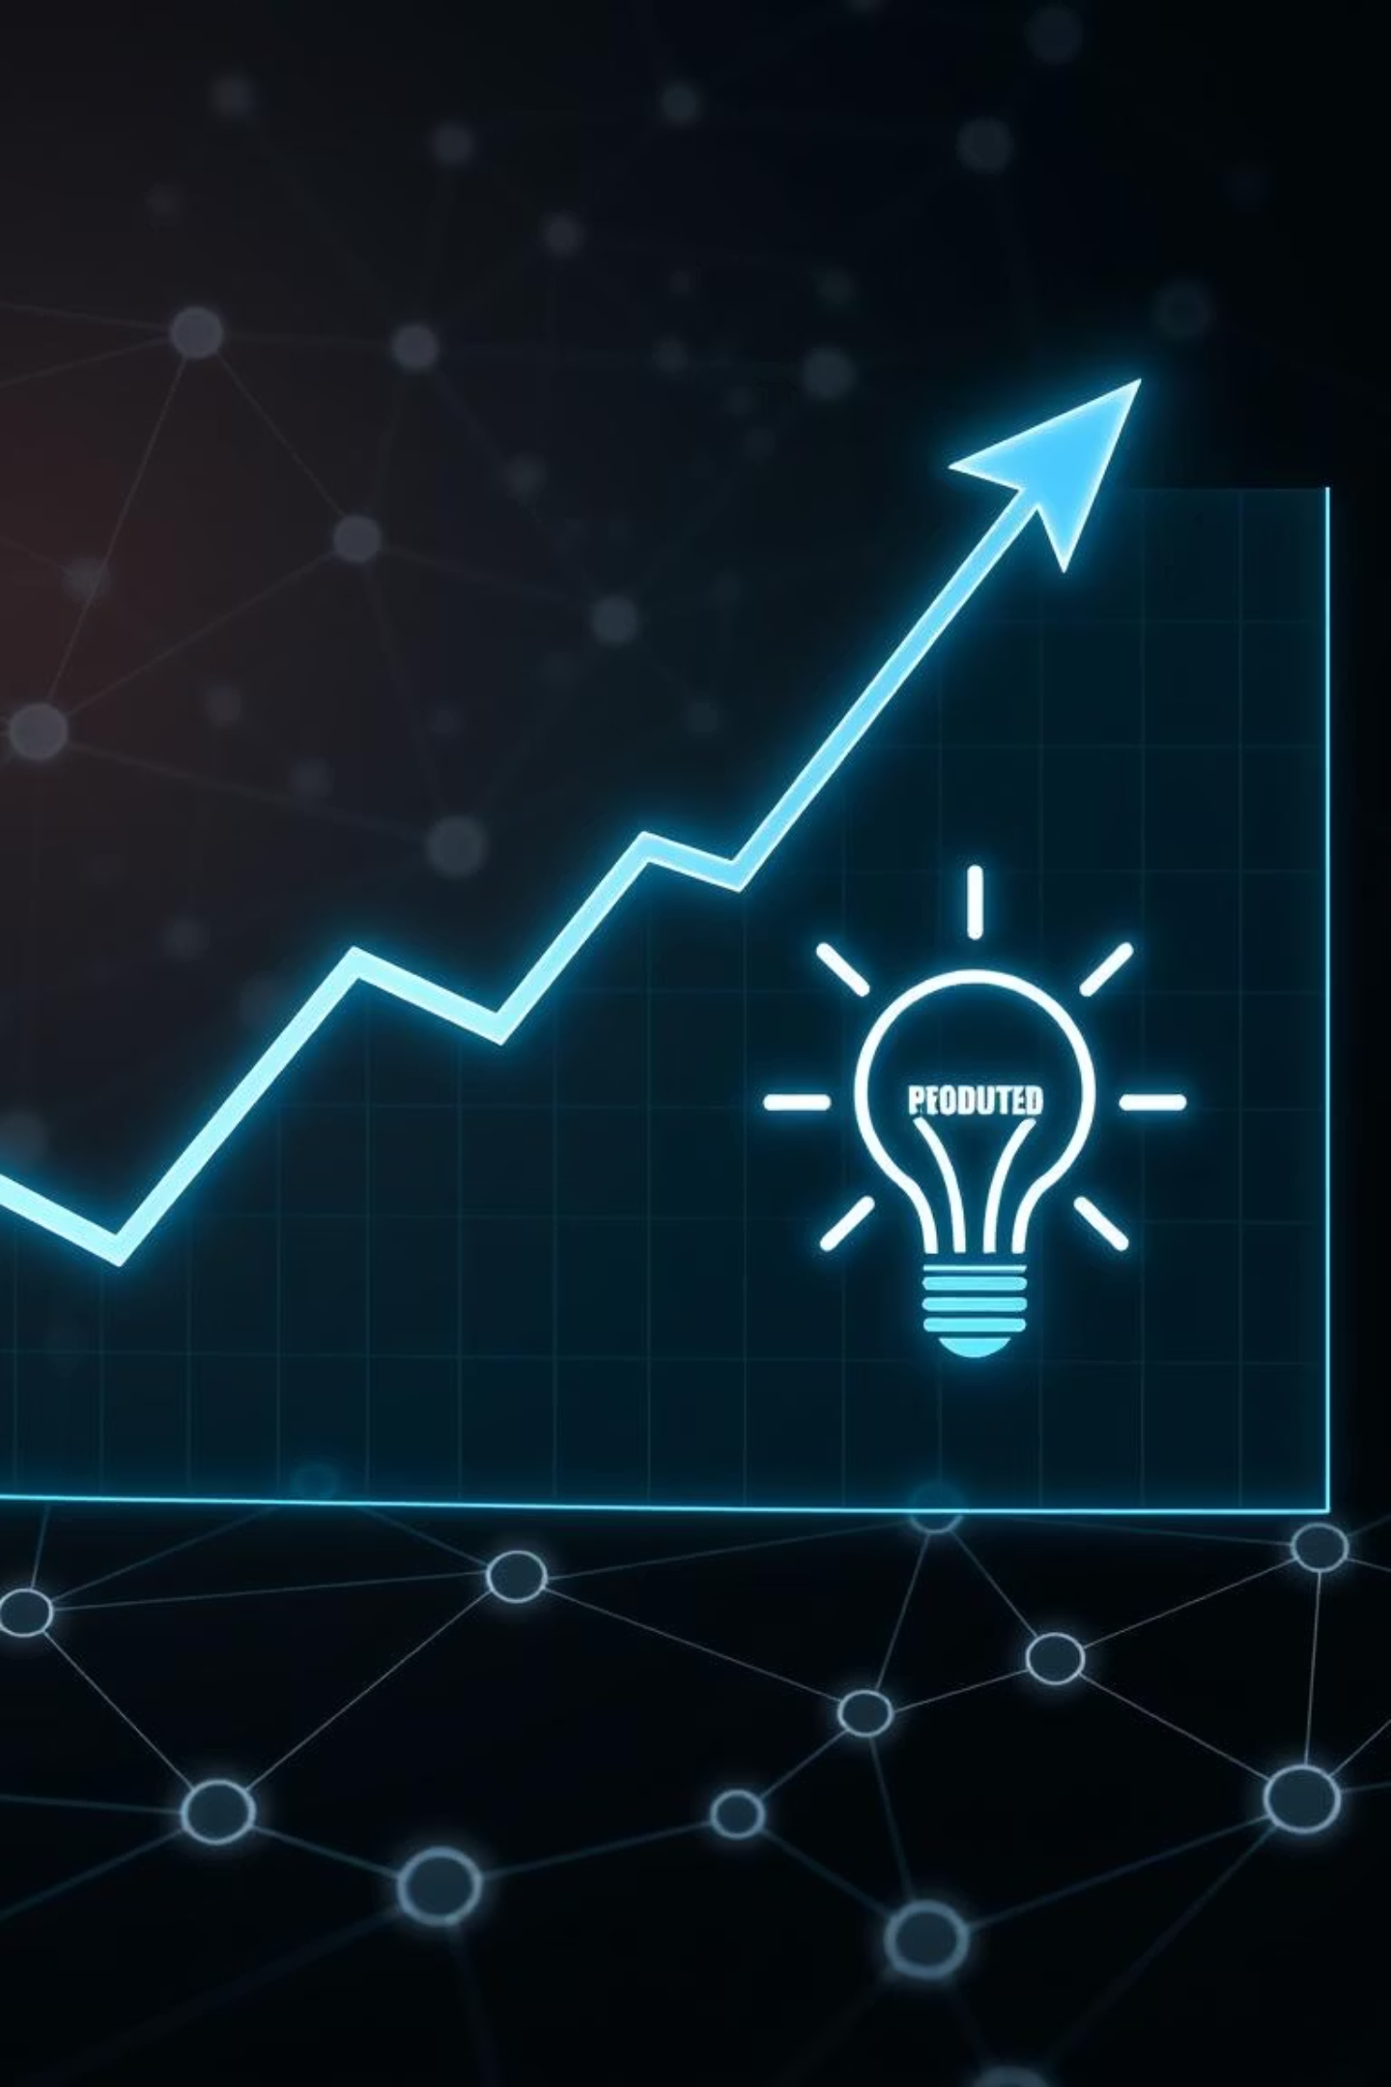
Benefits of Generative AI
—
—
—
Artificial Intelligence – Understanding intelligent systems and machine learning.
- Data Science and Analytics – Working with data for model training and evaluation
Programming and Algorithms – Writing and optimizing code for neural networks

Slide 13
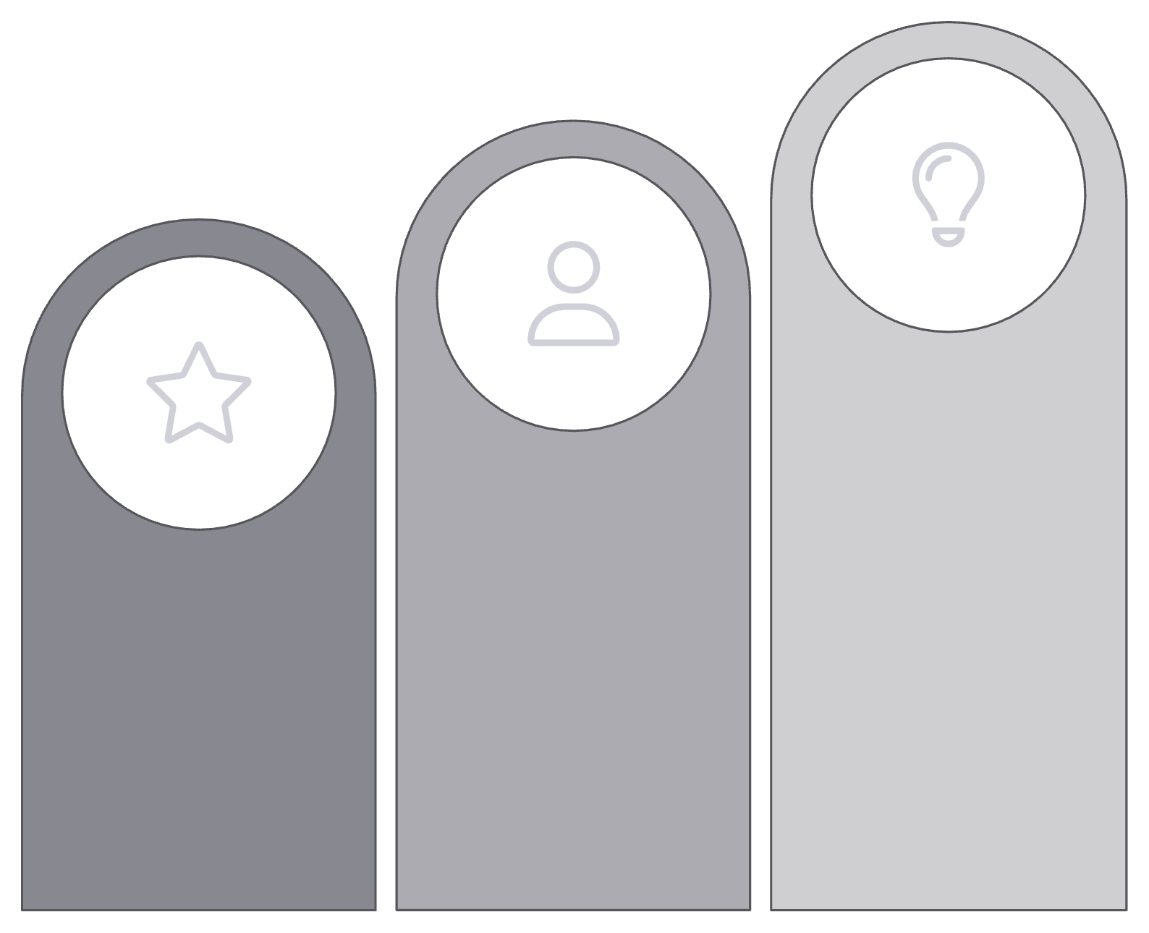



Future Trends and Innovations
Ethical AI
Personalized Generation
Multimodal AI
The future holds increasingly sophisticated and integrated Generative AI systems, pushing the boundaries of creativity and utility.

Slide 14
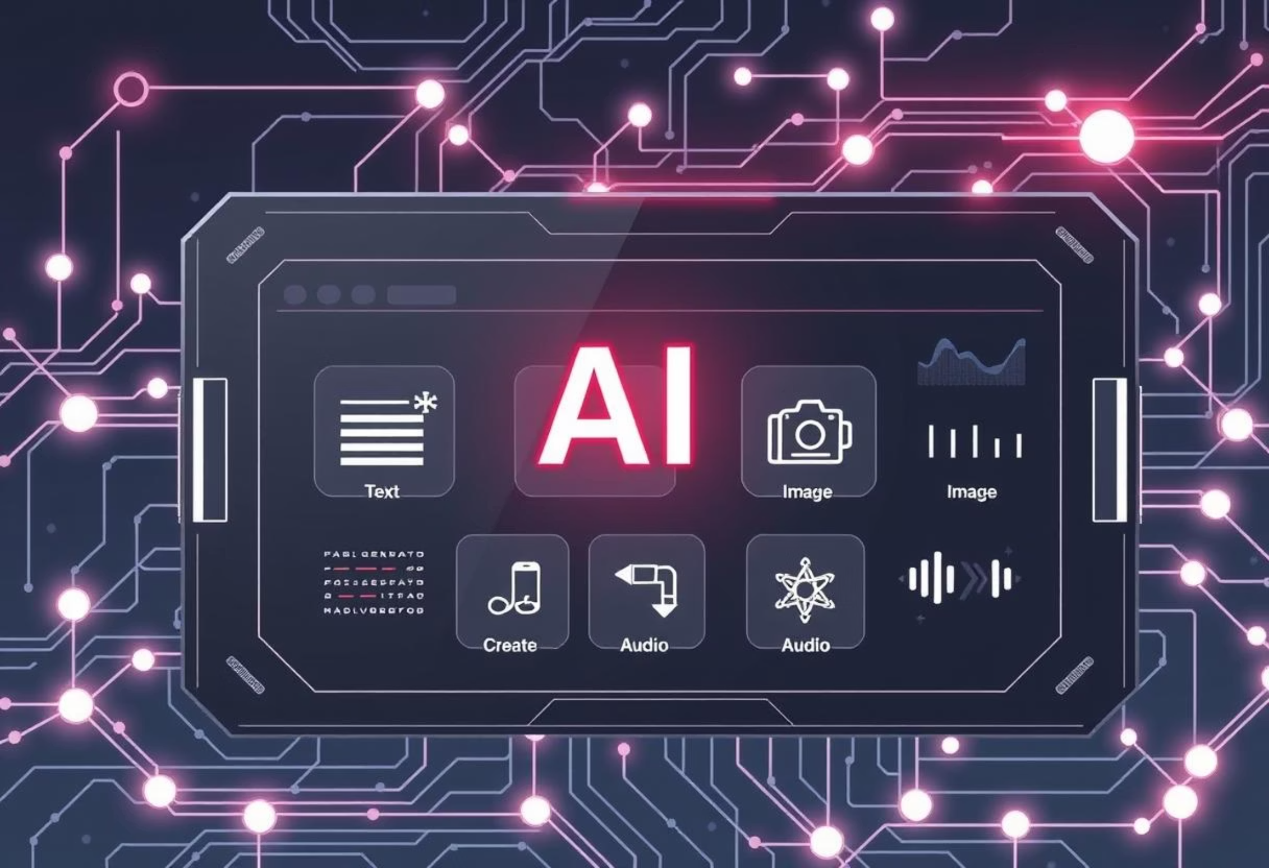
Generative AI Tools: A Landscape
Generative AI has spawned a rich ecosystem of tools empowering users across various creative and professional domains.
From generating compelling narratives to crafting stunning visuals and immersive audio, these tools are redefining workflows and
unlocking new possibilities.
Text & Content Generation
Image & Visual Design
Audio & Video Synthesis
Used for writing articles, marketing copy, summarizing documents, and creative storytelling
.
Enables creation of unique images, digital art, illustrations, and 3D models from text prompts.
Generates realistic voiceovers, musical compositions, and synthetic video clips for diverse applications.
Examples: ChatGPT, GeminiAI
Examples: Midjourney, DALL-E 3, Stable Diffusion
Examples: ElevenLabs, RunwayML

Slide 15
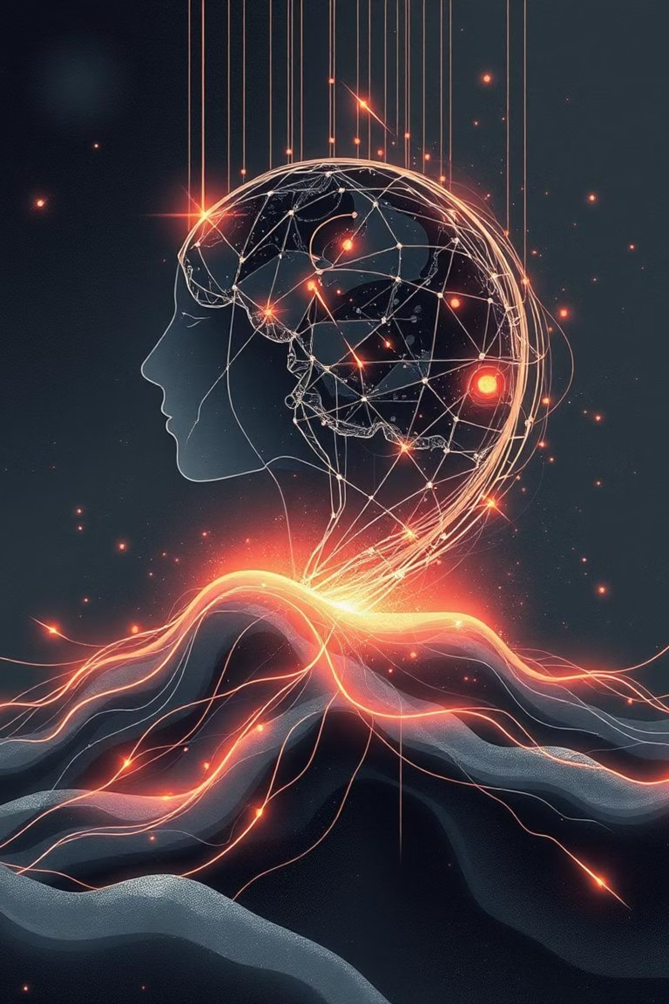
Generative AI: A Transformative Force
As we've seen, Generative AI is not just a technological advancement; it's a paradigm shift reshaping how we create, innovate, and interact with the digital world.
Unleashing Creativity
Empowering new forms of artistic expression and content creation across various domains.
Boosting Efficiency
Automating repetitive tasks, accelerating workflows, and driving innovation in industries.
Navigating Complexities
Requires careful consideration of ethical implications, bias, and responsible deployment.
Shaping Our Future
A collaborative journey where human ingenuity guides AI's powerful capabilities for a better tomorrow.
The journey with Generative AI is just beginning, promising an exciting future of endless possibilities.

Slide 16


